Slide 1
Vocational Rehabilitation Transition in Action

Slide 2
Why transition?
1
To identify and provide students with opportunities and necessary supports while they are in school that will lead to them achieving his/her postsecondary goals for employment, education/training and independent living
Notes:
Katie
As many of you may know, there are requirements in South Dakota that a school addresses transition services on an IEP by the time the students turn 16, if not earlier. This includes inviting adult agencies that could potentially provide services and supports to the student once high school is over. The large majority of the referrals VR receives come from IEP meeting requests. The transition process can be complicated and takes time to put together post-school services and supports. It’s easy for a student and their family to be overwhelmed during this process so the more frequently they hear about agencies that can help their student, the better they are preparing themselves for the transition process.
VR serves not only to provide services and supports, but we can also refer the student to other agencies if we aren’t able to assist. VR assists with the transition process by communicating with the IEP team to provide information the student needs to assist them with accomplishing their long-term employment goal. VR wants to make sure they are taking the appropriate classes and aware of programs that will benefit them from the beginning so they don’t get to their senior year short of skills that could have aided them with their employment goal once they are done with high school.

Slide 3
2
To help coach students and families to think about LONG-RANGE goals
To help design high school experience to ensure the students stay in school and be prepared for post-school goals
To help IDENTIFY and LINK students to any needed post-school services, supports or programs while they’re still in school
Notes:
Ronda
VR’s knowledge includes information about how a person’s disability could impact them on a job or at post-secondary educational institute. We are aware of the supports and services that could be available to them and understand the process they will need to go through to request these supports for the best chance at success.
When VR is given the chance to serve the students while still in high school, it allows us more opportunities to get to know the student and their family while providing necessary supports during high school and continuing to provide the necessary supports to them afterwards to aid in success whether its on the job or while attending post-secondary schooling to help make that transition as smooth as possible for the student.

Slide 4
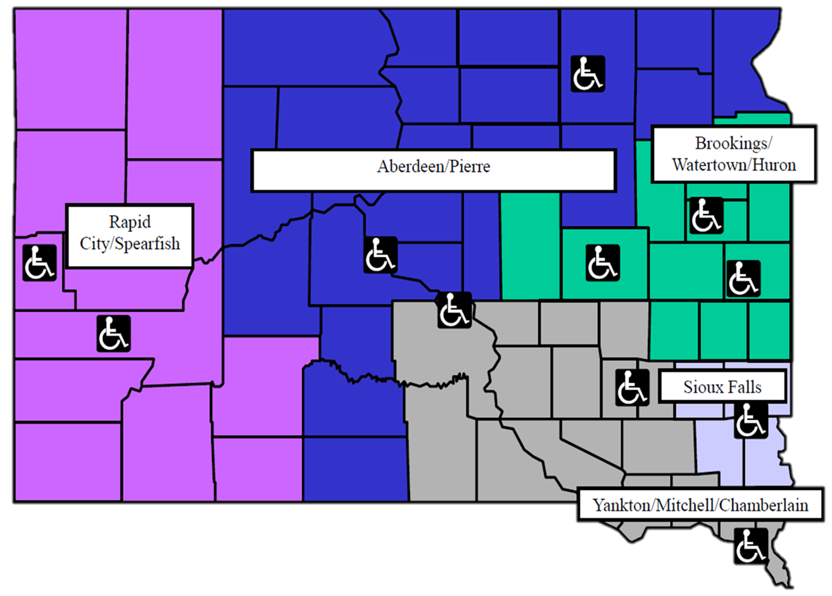
Notes:
Katie
Here is map that includes all of our district and satellite offices. Each school district is assigned a VR and SBVI counselor as well as a TSLP liaison. The Transition Service Liaison Project or TSLP have five liaison’s who work with schools and VR by providing technical assistance on the requirements of providing transition services. While TSLP is not a state agency, they are funded by DRS, SBVI and the Department of Education.
I would encourage you to go to the DHS Transition Resources website or contact myself to get the contact information for the counselor that covers the school you are planning to connect with so we can begin developing a working relationship.

Slide 5
Who is eligible for vr?
3
Must have a diagnosed disability that makes it difficult to work
Must benefit from VR services to get into the workforce or retain a current job
Notes:
Ronda
VR serves individuals from all ages starting at age 14 all the way up to some folks who are in their 80s. As long as they have a goal to work and a documented disability that is considered permanent, they will be encouraged to apply for services. This can be disabilities including mental illness, specific learning disabilities, cognitive impairments, hearing loss, vision loss, and/or physical limitations. Again, the disability must be permanent so it can’t be someone who broke their leg and is expected to make a full recovery after 6-8 weeks. A person receiving Social Security benefits is automatically eligible for services.
We have two vocational rehabilitation agencies in SD. One that specifically works with people with visual impairments, Services to the Blind and Visually Impaired. We specialize in all vision impairments and the services available but also work with people with multiple disabilities. For example, they can have a vision loss, but also experience a mental illness or have a physical limitation, for example. We are a small agency due to our specialty. The other VR agency is DRS, and they provide services to people with all other disabilities.
To determine if a person is eligible for VR services, the first step is to contact the local VR office to schedule an intake meeting so information can be gathered to determine if they meet the eligibility requirements listed. Please don’t assume that a person is or is not eligible for VR services, allow the VR counselor to make that determination.

Slide 6
Potentially eligible students
Students with Disabilities age 16 to 21:
Individualized Education Plans;
504 Plans; OR
Students with disabilities not identified with the school
Notes:
Katie
To be considered as a Student with disability – a person must still be in secondary school. Most are on an IEP, while others are on a 504 Plan, or some are students with disabilities who are NOT recognized by the school as having a disability. An example of this could be a student who utilizes a wheelchair for mobility but doesn’t require any specialized educational services, so they aren’t recognized by the school as having a disability since no additional supports are required of them.
Being on an IEP or 504 plan doesn’t guarantee eligibility so it’s important to discuss these students with the VR counselor that covers that school district.
VR is also serving students who are potentially eligible for VR and could benefit from receiving Pre-Employment Transition Services. This means that they have a diagnosed disability and meets the definition of student with a disability but have not applied for services yet. In most cases, these students have attended one of the transition events that I’ll be speaking on soon and/or the VR counselor has attended the student’s IEP or 504 meeting and could see how they would benefit from our services.

Slide 7
Job Exploration Counseling
Work-based learning experiences in an integrated environment
Post-secondary education counseling
Workplace readiness training to develop social skills & independent living skills
Instruction in self-advocacy
Notes:
Ronda
Due to federal regulations, VR is required to spend 15% of our federal grant money on providing Pre-Employment Transition Services to eligible or potentially eligible students with disabilities. These include:
Job exploration counseling – Virtual Job Shadow, researching career ideas utilizing the DLR website
Work-based learning experiences – job shadows, career fairs, Project Skills, Project SEARCH, informational interviews with employers
Post-secondary education counseling – providing information about Project SEARCH or other 18-21 transition programs, encouraging attendance at Catch the Wave to learn the differences between accommodations and modifications, college visits
Workplace readiness training – eTrac, teaching soft skills, utilizing Skills to the Pay the Bills curriculum, Let’s Talk About Work events, available 18-21 programs, summer Pre-ETS programs
Instruction in self-advocacy – encourage participation in YLF and being an active participant at their IEP team, utilizing the I’m Determined curriculum,

Slide 8
Transition Specific Services
Project Skills/Employment Skills Program
Project SEARCH
18-21 Programs
Youth Leadership Forum
Catch the Wave
Let’s Talk About Work
eTrac
Virtual Job Shadow
Transition Week at SDRC
SD School for the Blind
https://dhs.sd.gov/rehabservices/transitionresources.aspx
Notes:
Katie
In South Dakota, we have some unique programs and services available to students with disabilities.
Project Skills is available to students on an IEP where the students become temporary employees of the state and receive job search assistance, job coaching, and on-site monitoring from their school districts. Employment Skills Program is for students on 504 plans where again they become a temporary employee of the state, but job search assistance, job coaching, and on-site monitoring is paid for and provided by VR. The purpose of these programs is so students can start some paid work-based learning experiences and to determine what level of support those students need to be successful employees.
The purpose of Project SEARCH is to help students with disabilities find integrated, competitive employment after participating in a variety of internships at the SEARCH site. Project SEARCH has 5 sites in SD – medical sites in Sioux Falls, Aberdeen, Rapid City and Sturgis and a college site in Brookings at SDSU. Students are eligible to choose 3 different internships throughout the school year to learn more employability skills. Eligible participants must be 18-21, in their last year of school funding, and have a goal of working competitively in the community after SEARCH is complete.
18-21 programs have been designed for students who have finished all their educational requirements for graduation but are still in need of independent living and employment skills. These programs require that the student hold onto their HS diploma until they finish up this program. There are a few around the state and DRS is looking to assist more schools with costs to establish more 18-21 programs to encourage this opportunity for skills growth. These programs can be offered through a school district or one of the post-secondary programs available if the school is agreeable to the costs associated. Students in South Dakota have accessed 18-21 post-secondary programs at Augie Access, Northwestern Next, DWU and SAVE. These four programs focus on giving students with disabilities the post-secondary experience while focusing on those IL and employability skills on a post-secondary campus, some of which provide dormitory options for the students. SAVE and Northwestern Next are both located in Iowa but have accepted SD students into their programs which is why I mention them today.
Youth Leadership Forum or YLF is a week-long summer camp for students with disabilities hosted by TSLP. Here they are learning leadership and self advocacy skills while having fun! This camp is usually held at Northern State University in Aberdeen SD the first week of June.
Catch the Wave is a day event where students with disabilities learn the differences between high school and post-secondary services and how to advocate for those services to receive appropriate supports while earning a degree. Let’s Talk About Work is also a one-day event for students with disabilities but the focus is all about what it takes to be good employees.
eTrac and Virtual Job Shadow are online platforms that counselors received access to after services moved to a virtual platform. eTrac is a soft skills program designed to help students understand the skills needed to search, apply, interview, and accept employment while VJS is a program that allows for career exploration through a series of career and life skills videos.
For more information on any of these services, feel free to check out the DHS Transition Resource website. You will also find the listings of schools and which VR and SBVI counselor covers particular schools.

Slide 9
Notes:
Ronda
The list of services on this slide are not all that can be provided by the VR counselor. All VR services are individualized to meet the client’s needs and choices of services to assist them with accomplishing their employment goal so these are just a few basic services.

Slide 10
Notes:
Katie
These services require that the client meet our financial need requirements for financial assistance.
People receiving SS benefits automatically meet VR’s financial needs requirements. There are also certain items that VR can purchase for students with disabilities that don’t require financial need, but they would need to talk to their counselor for more information.

Slide 11
Hello!
I am Jaden. I was diagnosed with congenital glaucoma and want to find a job after high school that doesn’t require additional schooling. I have no prior work experience. What can VR do for me?
Notes:
Ronda
If Jaden applied and was found eligible for VR services, here are just some of the services we could provide him.
We would begin discussing what soft skills are needed to be a good employee by having him work through the eTrac program, attend a Let’s Talk About Work event or Bring Your ”A” Game, or one of the summer camps that focuses on Pre-ETS topics. We could have Jaden participate in some career assessments through Virtual Job Shadow or the DLR website to begin exploring careers that might be of interest to him to learn about job availability, potential earnings, and Hot Careers. Once we have started that list, we can start arranging for job shadows and informational interviews with employers in the field to begin learning more. The virtual World of Work training through the SD Rehab Center could assist with interviewing, searching for work and preparing for employment. If the school agrees, we can look for Project Skills jobs to begin getting paid work experience in the field that will allow him informed choice about whether this is something he wants to continue pursuing.
There are many summer opportunities to work on transition services, including Transition week at SDRC where students receive independent living and employment training for a week, staying at the Augustana University dorms at night. Students learn about assistive technology, orientation and mobility training, independent living skills, business tours and employer contacts.
While these activities are happening, we can make sure he is being referred to other agencies that might be able to assist him with independent living skills and long-term services if they are needed. We can also discuss potential participation in local 18-21 programs or Project SEARCH. Helen Keller National Center also offers summer transition assessment and training for students who have combined hearing and vision loss.
Once he receives his high school diploma, whether that’s at 18 or 21, we can use the information gathered in previous services to begin searching for a career within his chosen field and offer to provide the supports needed to be successful there.

Slide 12
Hello!
I am Katherine. I have a specific learning disability in reading and math. I have been accepted to attend a vocational institute to pursue an education to become an LPN. What can VR do for me?
Notes:
Katie
If Katherine was found eligible for VR services, there are several services that VR could help her with while in high school and at the vocational institute if the goal is compatible with her abilities, interests, and limitations. For the sake of this example, the counselor has agreed that Katherine becoming an LPN is worthy of exploring.
While in HS, we could help her pick courses that would compliment her employment goal of LPN by encouraging her to investigate CTE courses, assist with a paid work experience to help her get hand-on experience in the health field, help her understand what accommodations and modifications she receives in HS to discuss if any can follow her, while also encouraging her to attend Catch the Wave and apply for the Youth Leadership Forum. We can help her research the schools that offer the LPN degree, provide guidance on applying for schools and FASFA.
Once she has her signed diploma, we could talk about any assistive technology devices that may help her at school and purchase them as well as provide training, if needed, to use them properly. Get her connected with the school’s disability coordinator to request accommodations. If she meets financial need, we could also look at assisting with costs associated with tuition, fees, and books after the federal grants are considered. While providing supports at the vocational institute, we can further assist with employment experiences and supports until she graduates then move into searching for employment that utilizes her newly obtained degree.

Slide 13
Ronda Williams (SBVI)
605.773.3195
Ronda.Williams@state.sd.us
Katie Gran (DRS)
605.367.4657
Katie.Gran@state.sd.us
https://dhs.sd.gov/rehabservices/transitionresources.aspx
https://dhs.sd.gov/servicetotheblind/default.aspx

